Slide 2
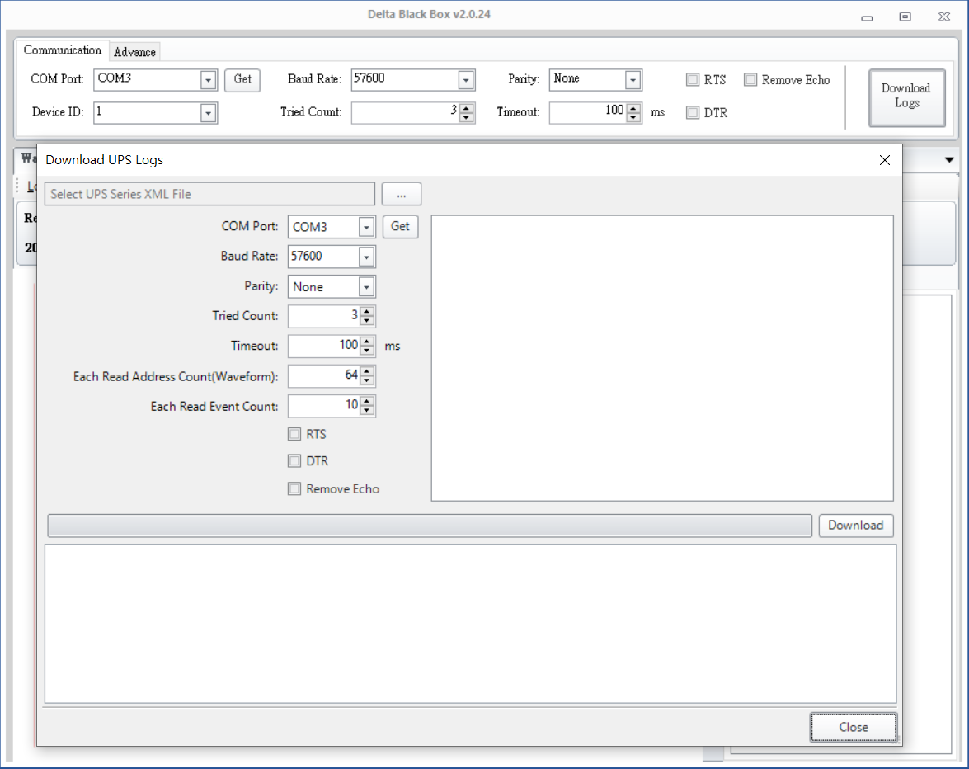
Delta Black box
One click for downloading waveform log& event log
1.Unzip files “Delta Block Box v2.0.24”.
2.Click to enter the folder “Delta Block Box v2.0.24”, and open the main program “DeltaBlackBox
3.To use the one-click download feature, click “Download Logs” in the top right corner, and a new window will open.
1
2

Slide 3
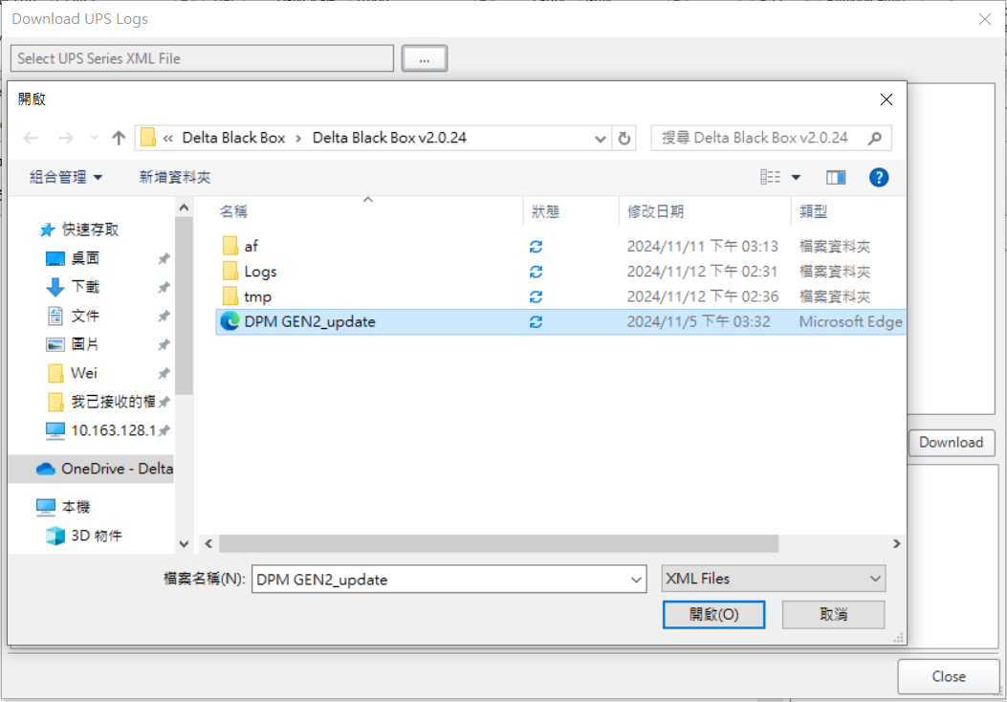
Delta Black box
4.Click the button at the top of the window and select “DPM GEN2_update”
1
2
3

Slide 4
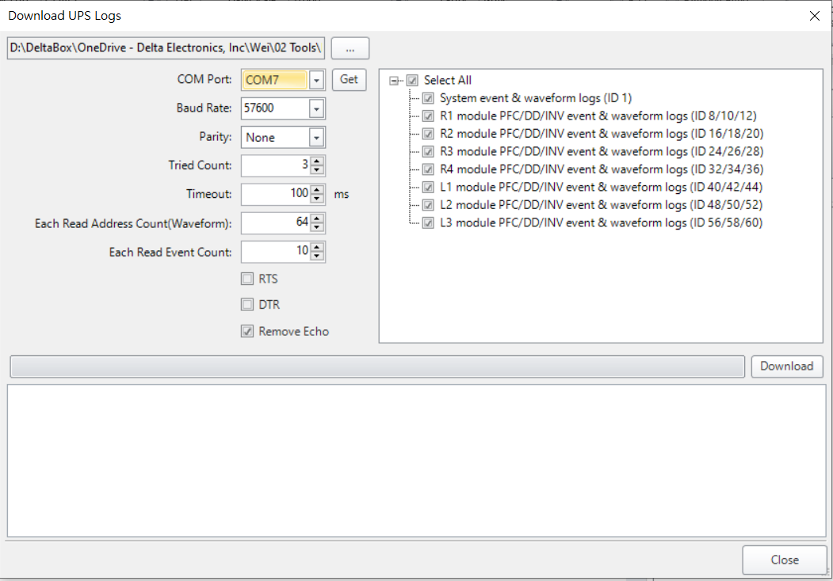

Delta Black box
3
5-1. Select the COM port.
5-2. Check “Remove Echo”.
5-3. Select the module to download.
5-4. Click “Download”.
5-5. The window below will display
“Start Downloading”.
1
2
4
5

Slide 5
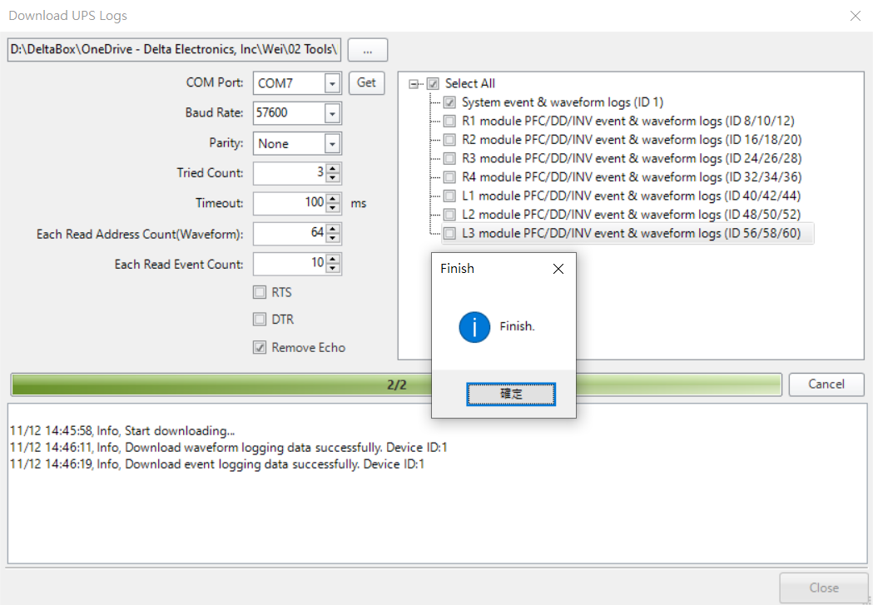
Delta Black box
6.Wait for the completion window.
7.After the download is complete, the downloaded compressed file will appear in the folder.

Slide 6
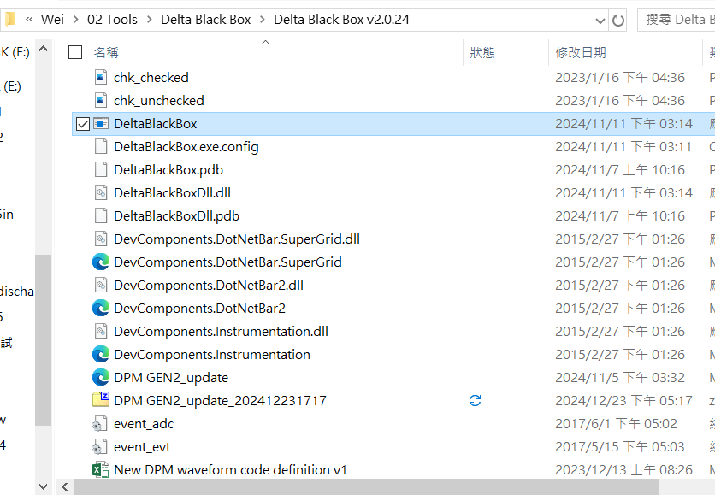
Delta Black box
7.After the download is complete, the downloaded compressed file will appear in the folder.

Slide 7
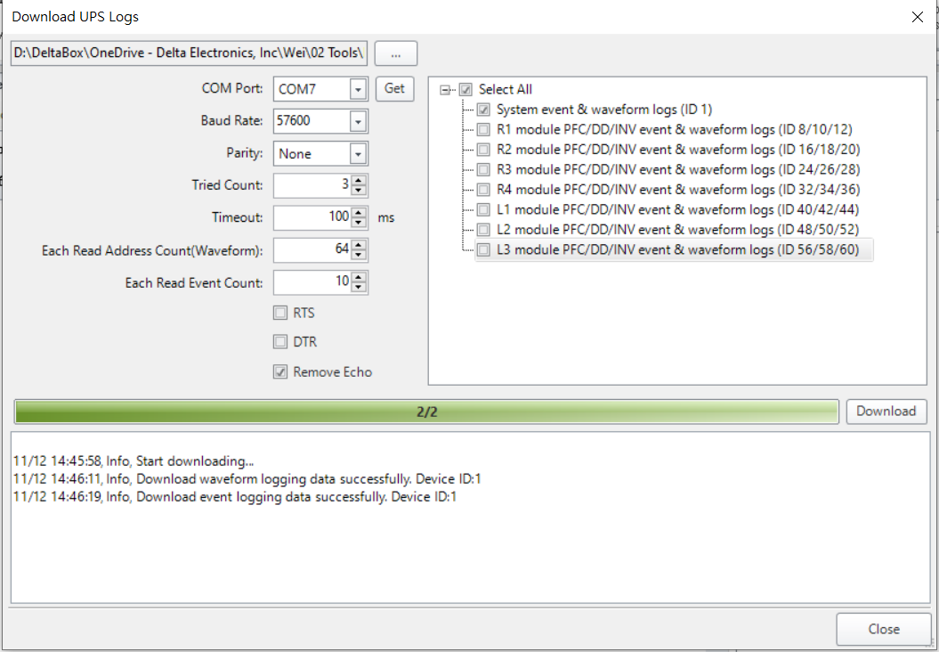
Delta Black box
NOTE: To download again, simply reselect the module you want to download and click “Download”.

Slide 8
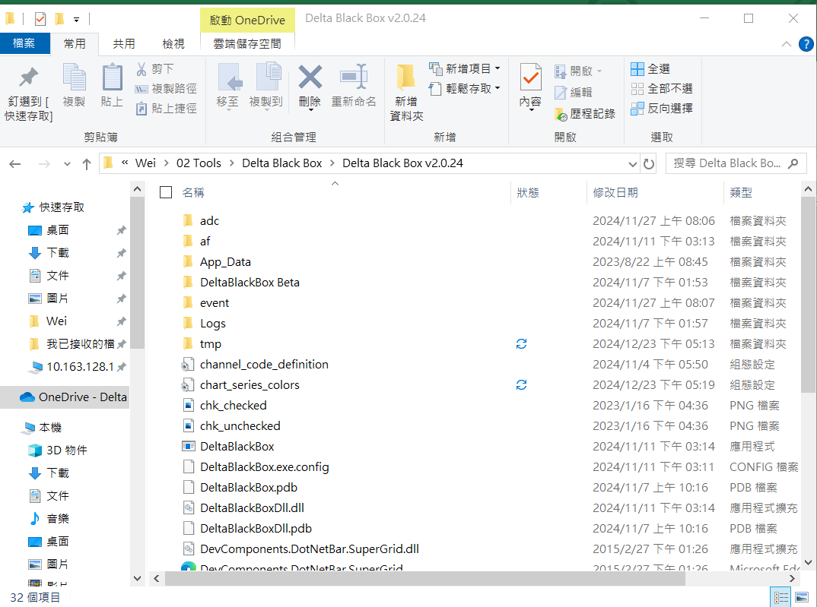
Delta Black box
NOTE: If clicking "download" has no response, please delete the "tmp" folder.

